Slide 1
Guess the word

Slide 2
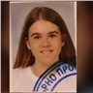
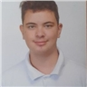
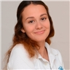
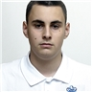
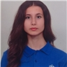

Participants
Kamelya
Yaneva IX G
Kaloyan Pazlamachev IX B
Vesela
Dekova IX A
Andrey
Andreev IX G
Petya
Petkova IX V

Slide 3

Everyone’s work

Slide 4


Theme

Slide 5







Used technologies

Slide 6


Organization time

Slide 7
Video of our project

Slide 8
Thanks For
Your Attention

